Slide 1

HR Salary Dashboard – Train the Dataset and Predict Salary Project Synopsis Presentation Date: 06/10/2025
Industrial Training (ECS599)
Degree : B.Tech–CSE-Specialization in Data Science (in collab with TCS ion)
Project Guide:
Mr Ajay Rastogi
Submitted By:
Darshil Jain (TCA2365006)
FACULTY OF ENGINEERING & COMPUTING SCIENCES
TEERTHANKER MAHAVEER UNIVERSITY, MORADABAD

Slide 2

Team Details
Student Name | Role
Darshil Jain | End-to-End Machine Learning & Dashboard Developer
LINK TO CODE AND EXECUTABLE FILES
Link to GitHub: -TCS-iON-RIO-125-HR-Salary-Dashboard---Train-the-Dataset-and-Predict-the-Salary-by-TCS-iON
Executable file: http://localhost:8888/notebooks/HR%20Salary%20Prediction-2nd%20Interim.ipynb#
2

Slide 3
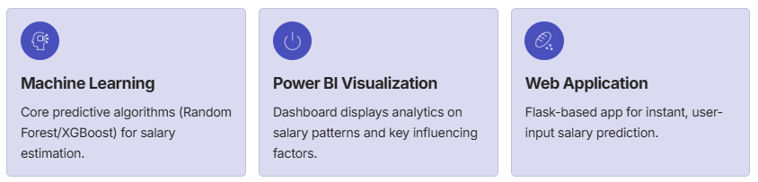
Project Brief
The "HR Salary Dashboard – Train the Dataset and Predict Salary" project is designed to create an intelligent HR analytics system. It predicts employee salaries by leveraging key factors like experience, education, job role, and skill set.
Key Modules and End to End Automation:
Data Preprocessing
Handles missing values and prepares the dataset.
Exploratory Data Analysis (EDA)
Identifies salary trends, correlations and insights.
ML Model Training
Trains algorithms for accurate salary predictions.
Visualization & App
Deploy results via Power Bi and a live web application.
3

Slide 4
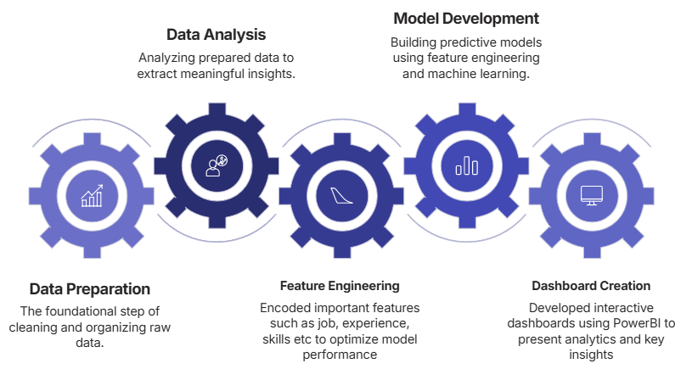
Methodologies/ Technologies/ Tools to be used
Key Methodologies
Core Technologies
Python: Main language for data, ML, and web.
Scikit-learn/XGBoost: For predictive model building.
Pandas/NumPy: For data handling and transformation.
Flask: For the interactive web application.
Power BI: For dashboard and visualization.
HTML/CSS: For web app user interface.
Development Tools
VS Code: Primary development environment.
Power BI Desktop: For reporting and analysis.
GitHub: Version control and collaboration.
Pickle: Saving and loading trained models.
4

Slide 5
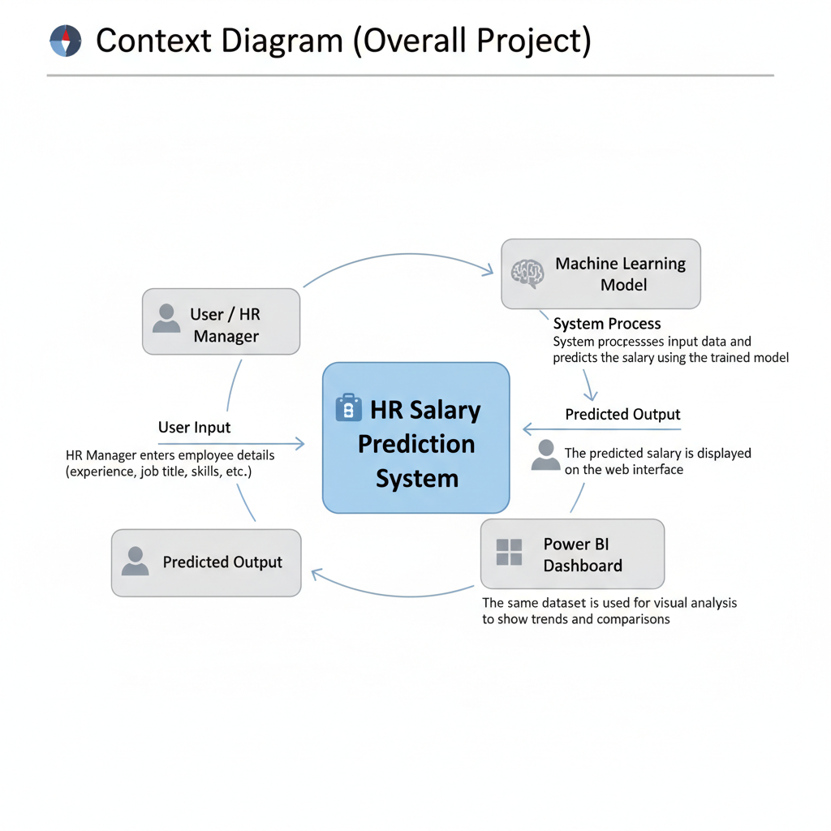
Context Diagram (Overall Project)
5

Slide 6
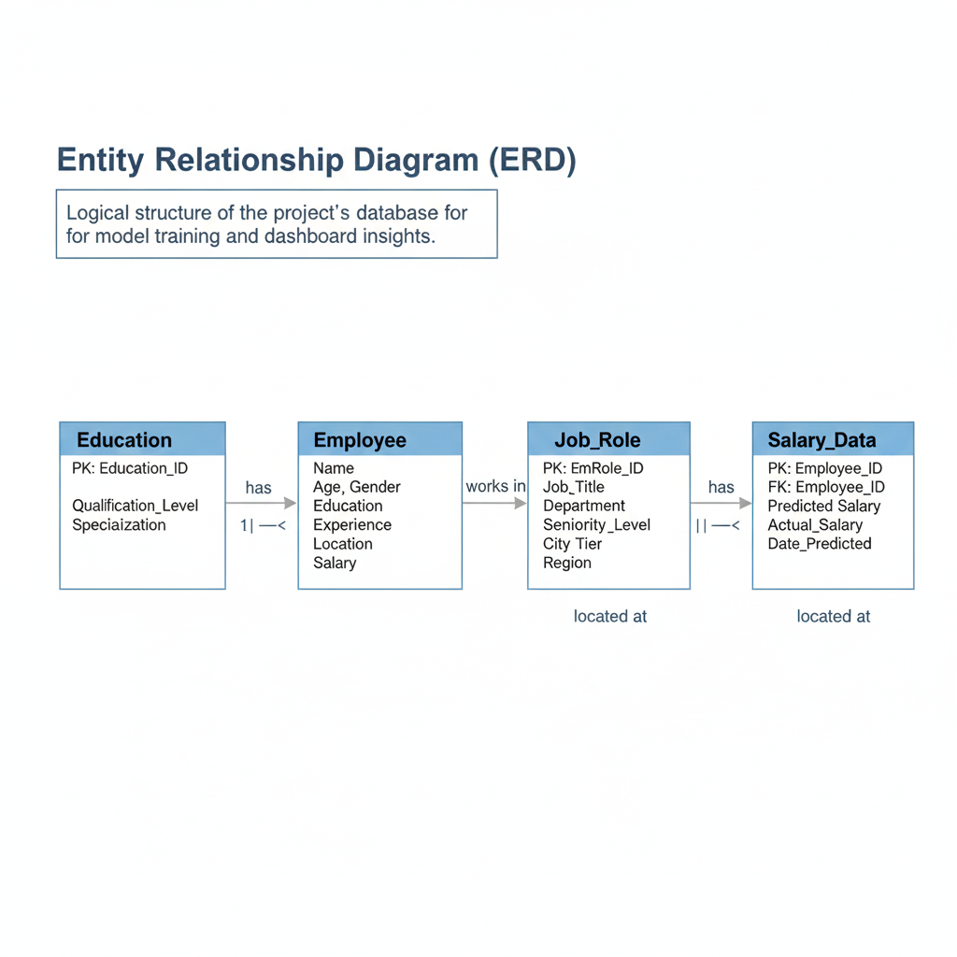
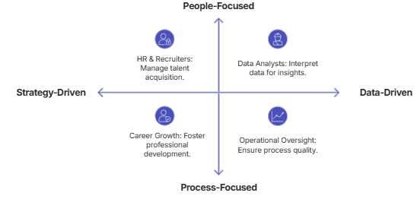
Entity Relationship Diagram (ERD)
6

Slide 7
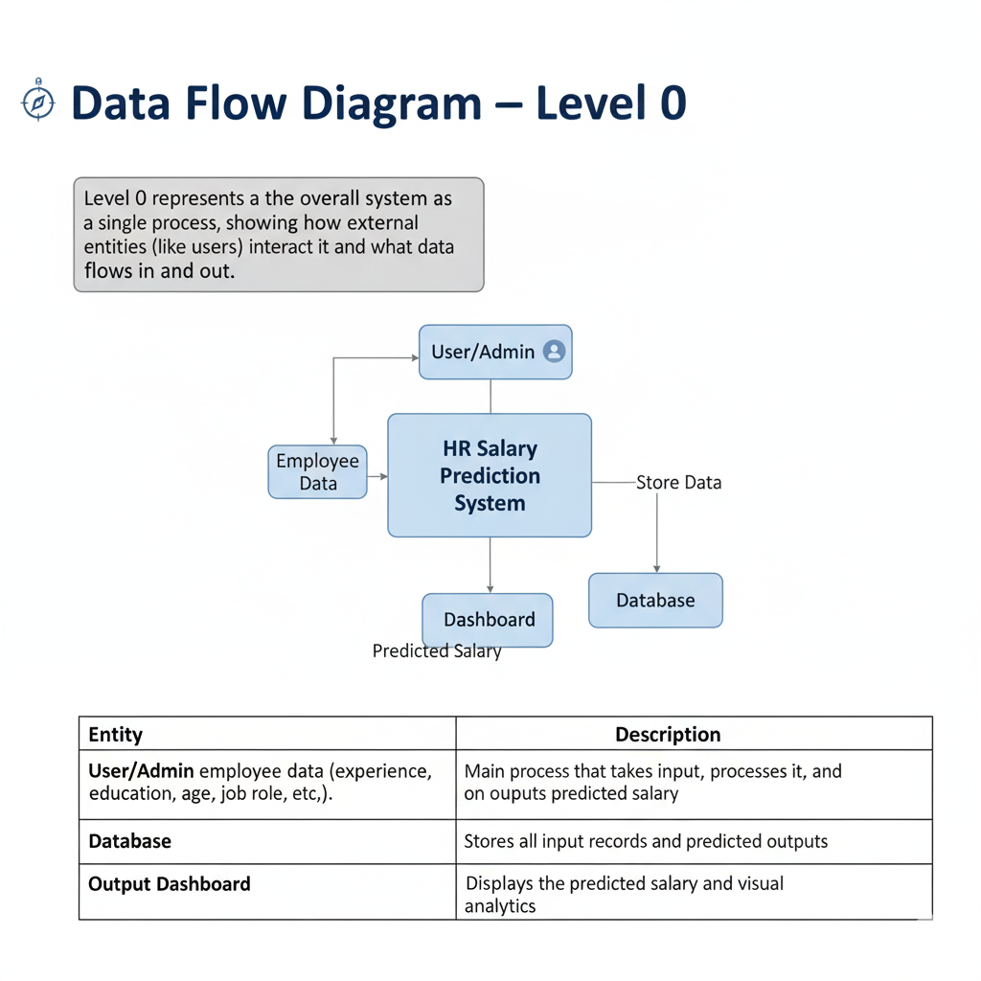
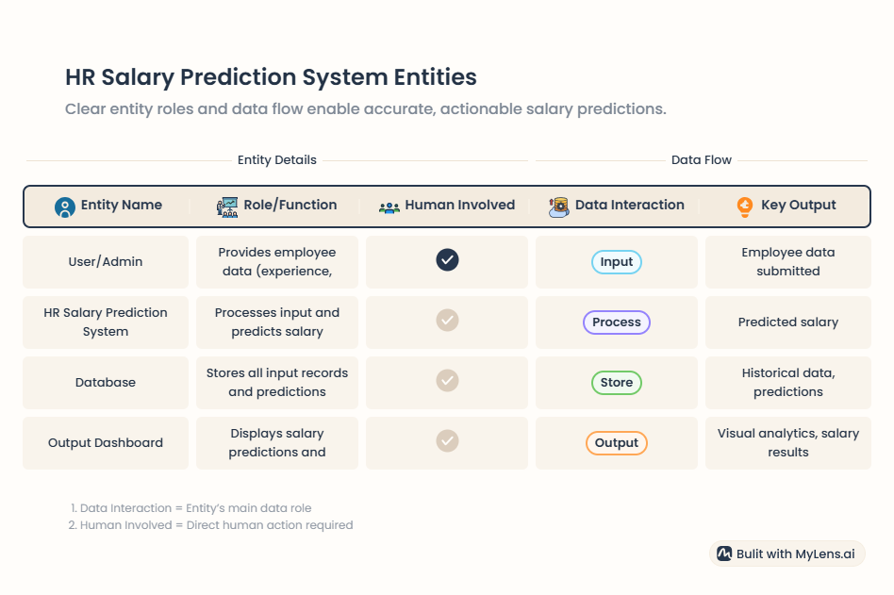
Data Flow Diagram (DFD)
7

Slide 8
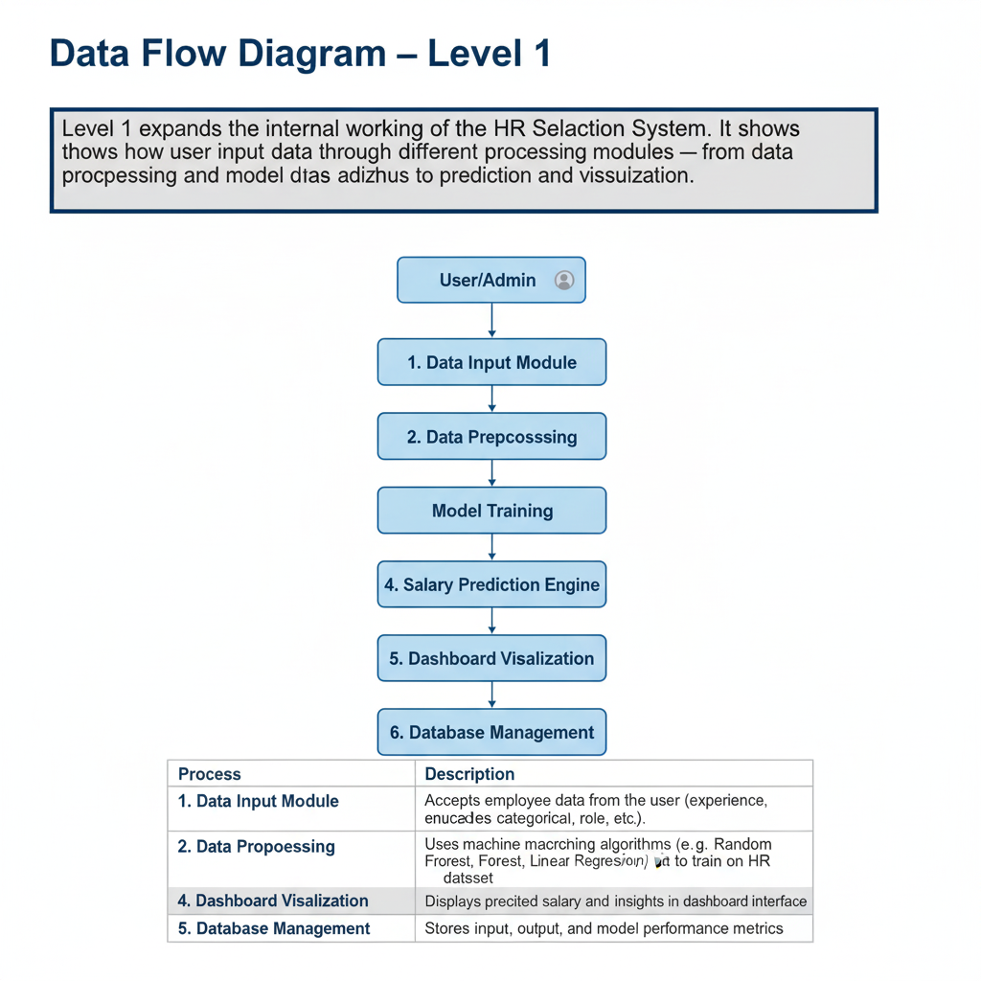
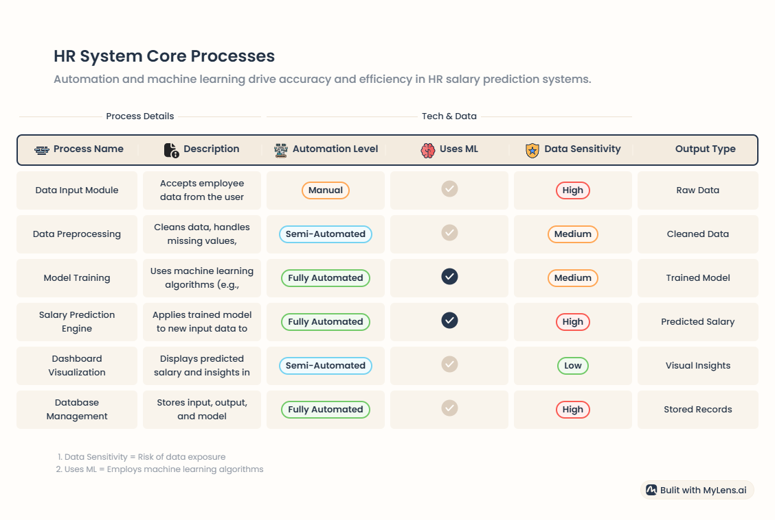
Data Flow Diagram (DFD)
8

Slide 9
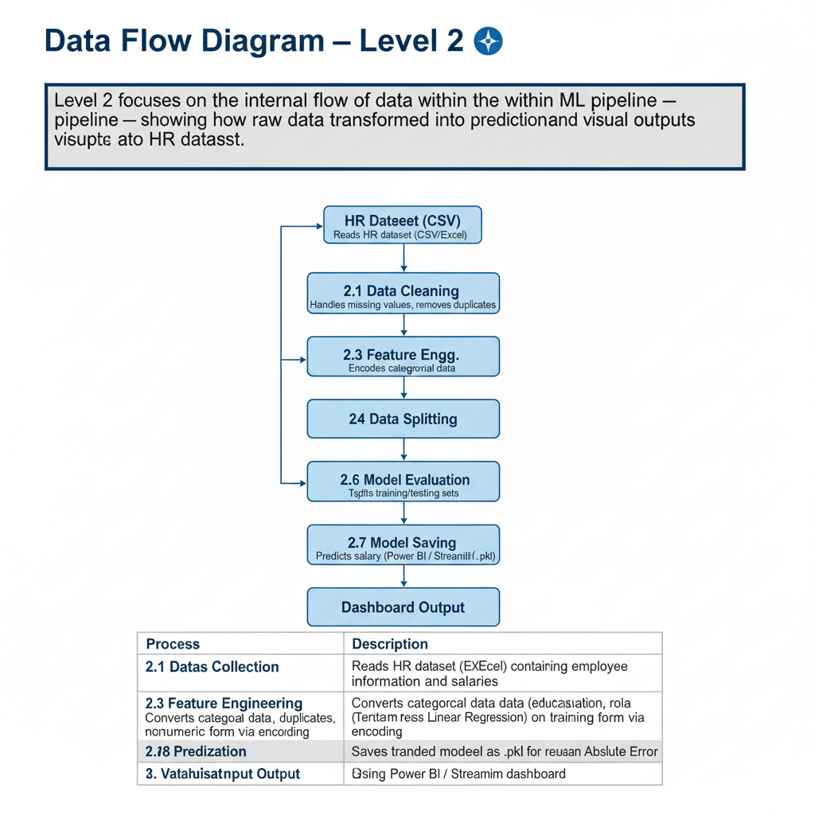
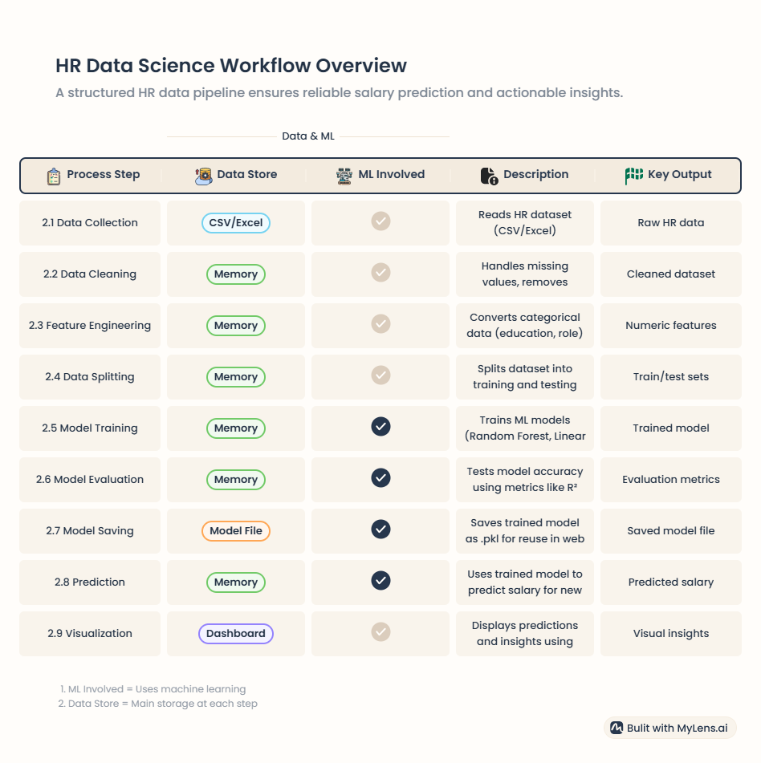
Data Flow Diagram (DFD)
9

Slide 10
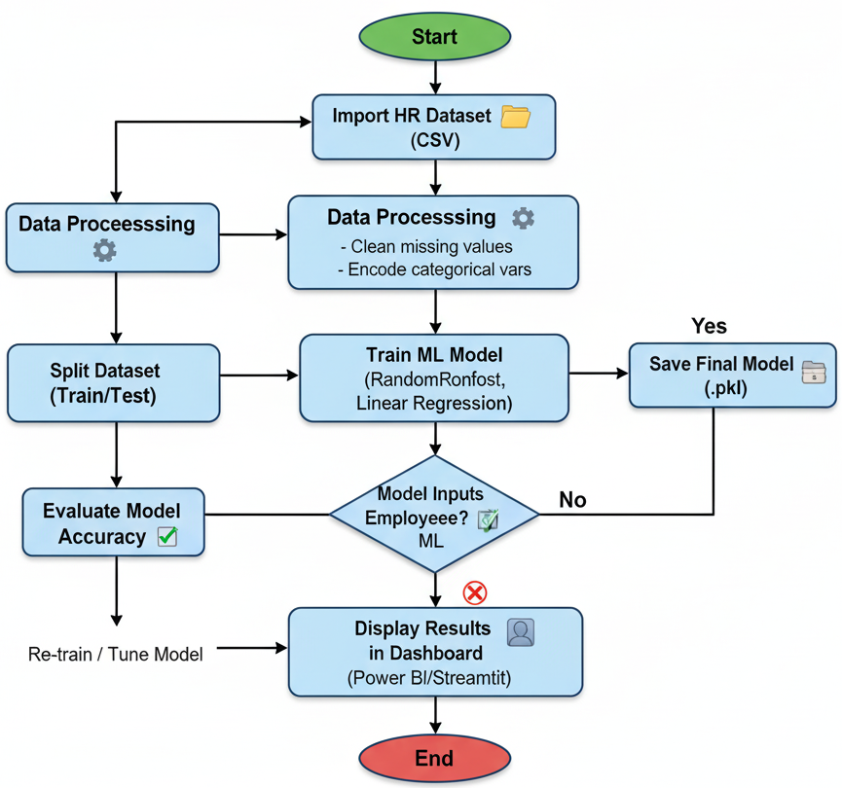
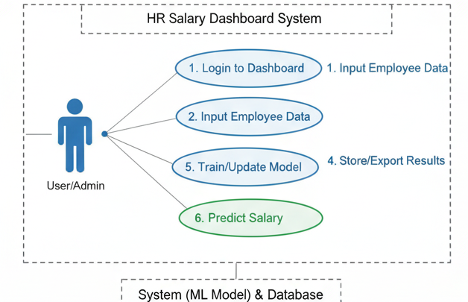
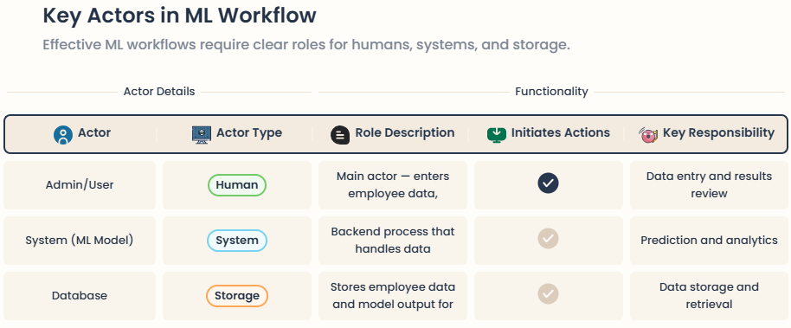
Flow Chart
10

Slide 11
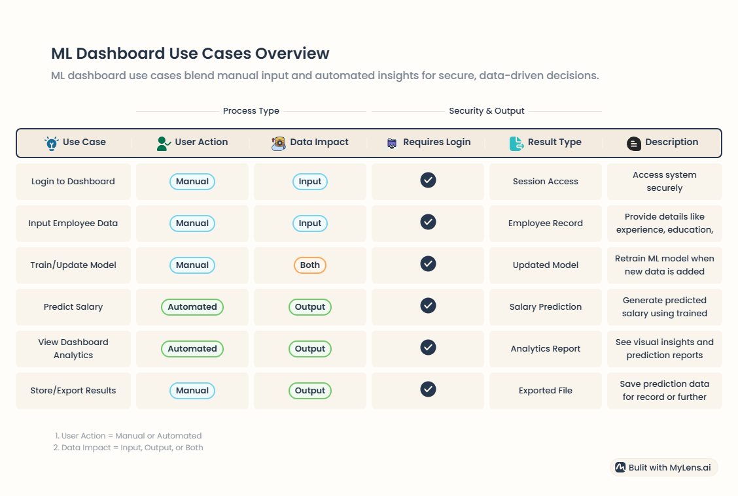
Use Case Diagram
11

Slide 12
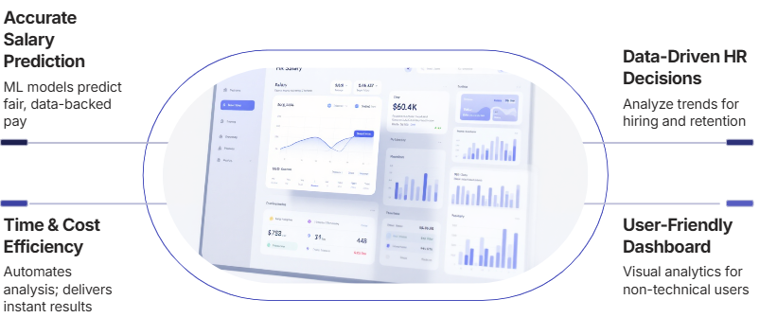
\
Advantage of The Project
12

Slide 13
References, if any
The following resources, tools, and documentation were referred to during the design, development, and deployment of the HR Salary Dashboard project.
Kaggle Dataset: HR Employee Salary Prediction Dataset. Retrieved from https://www.kaggle.com/
Scikit-learn Documentation: Machine Learning in Python. Available at https://scikit-learn.org/stable/
Pandas & NumPy Libraries: Python Data Analysis Library. Available at https://pandas.pydata.org/ NumPy Documentation. Available at https://numpy.org/
Matplotlib / Seaborn Libraries: Data Visualization in Python. Documentation at https://matplotlib.org/
Streamlit Framework: Build Data Apps in Python. Retrieved from https://streamlit.io/
Power BI Documentation: Create Interactive Dashboards. Available at https://learn.microsoft.com/en-us/power-bi/
TCS iON RIO-125 Problem Statement: HR Salary Dashboard – Train the Dataset and Predict Salary. Accessed from TCS iON RIO Project Portal.
13

Slide 14
THANKS

